Slide 1
Welcome to all
for the MHRM Online lecture
By
Dr. Dhiraj Ovhal
HOD of Commerce

Slide 2
Chapter -2
Marketing Decision –I
(Product and Price)

Slide 3
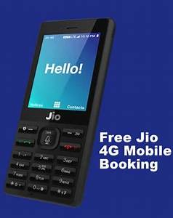
Chapter -2
Marketing Decision –I
(Product and Price)

Slide 4
Q.7 What do you mean by Pricing and Explain the Objectives ?
Meaning:-
Price means exchange value of products. Seller is ready to sell and buyer is ready to accept at agreed price.
The marketer should keep right price as per the competitors price strategy. It should not keep high price because no one like to purchase with high price and low price create doubt about quality of the products.
( Exchange value... No high or low price Right price..)
( Penetration price means low price and Skimming price means High price)

Slide 5
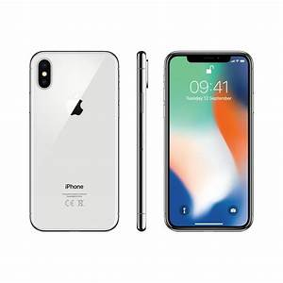
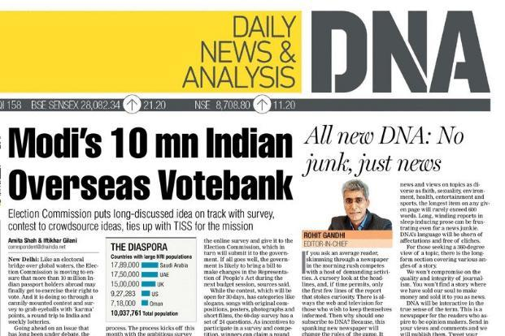
Skimming Price Strategy
Penetration Price Strategy

Slide 6
1 . Survival
2.Profit
3.Sales
4.Competation
5.Customer satisfaction
6.Skimmimg pricing
7.Pentration pricing
8.Social responsibility
Objectives :-

Slide 7
Survival :-
Lockdown situation and Pandemic Corona virus
Nowadays survival is main things for the business
To face the competition
To face recession

Slide 8
2. Profit :-
Return on Investment
Profit maximization

Slide 9
3. Sales:-
Market share growth
Sales growth
Capture new market

Slide 10
4. Competition :-
To reduce price to face competition
Offer various price on festival or special occasion to attract customers.

Slide 11
5. Customer Satisfaction :-
Best quality with reasonable price
Prime focus on customer satisfaction
 | Product performance | Customers
1 | Product performance matches with Customer Expectation | Satisfied
2 | Product performance below than with Customer Expectation | Dissatisfied
3 | Product performance more than with Customer Expectation | Delight
4 | Product performance exceed more than with Customer Expectation | Astonished

Slide 12
6. Skimming pricing :-
High price--- Main objective to recover early cash or profit
Scream the cream
Technology product
Fashionable product

Slide 13
7. Penetration Pricing :-
Low price--- Main objective to capture the market
To face the competition

Slide 14
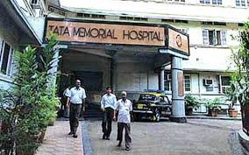
8. Social responsibility :-
Doctor :- Fees

Slide 15
1 . Survival
2.Profit
3.Sales
4.Competation
5.Customer satisfaction
6.Skimmimg pricing
7.Pentration pricing
8.Social responsibility
Objectives :-

Slide 16
Thank You

Slide 17
Attendance Link
https://forms.gle/Xqvykv5vfEi1zpyF7
(Mention date at last point)

